Slide 1
AIES MINI PROJECT TOPIC: AI AGENT LEARNS TO WALK
Group No:
Group Members: Ameya Khire PB 5
Sahil Ranawade PB 16
Deven Chhajed PB 32

Slide 2
CONTENTS
Introduction
Purpose
Technology Stack
Demo
Challenges Faced
Future Enhancements
Bibliography
Conclusion

Slide 3
INTRODUCTION
Artificial intelligence (AI) helps machines do things that humans can do.
Our project is about teaching a computer program to do something that seems easy for us but is actually quite tricky for a machine: walking.
Walking might seem simple, but it's a complex skill that defines how we move.

Slide 4
Purpose
Our main goal is to show how smart computers can be by teaching them to walk.
We're using different computer techniques and making a pretend world for the computer to learn in.
The aim is to train a computer program, bit by bit, so it can walk on its own, just like we do.

Slide 5
Technologies used
OpenAI Gym
TensorFlow Agents
ImageIO
Python Libraries
Base64 Encoding
Leveraged for providing the Bipedal Walker environment, allowing simulation and interaction with the RL agent.
(tf_agents) Framework utilized for implementing and managing RL agents, training loops, and policies.
Used for handling video generation and frame rendering for visualizing the agent's behavior.
Utilized various Python libraries for data handling, visualization, and general-purpose programming.
Employed for embedding MP4 videos into the Jupyter Notebook for visualization within the presentation.

Slide 6
Challenges Faced
Complex Environment: Bipedal Walker's complex, high-dimensional state space poses algorithm design challenges.
Training Instability: RL training can be unstable, sensitive to hyperparameters, and prone to convergence issues.
Hyperparameter Tuning: Finding optimal settings (learning rates, discount factors) is time-consuming and critical for performance..
Overfitting and Generalization: Agents may overfit or struggle to generalize learnings to diverse scenarios.
Reward Design Complexity: Crafting effective reward structures to guide learning is intricate and requires experimentation.
Resource Demands: Training RL agents in complex environments demands significant computational resources.

Slide 7
Future enhancements
Advanced Algorithms: Implement cutting-edge RL algorithms (PPO, SAC) for improved performance.
Hyperparameter Optimization: Use automated methods for efficient hyperparameter tuning..
Reward Refinement: Improve reward structures for more effective learning.
Adversarial Environments: Train agents in diverse environments for enhanced adaptability.
Real-World Applications: Extend learned policies to real-world or simulated scenarios.
Optimization Techniques: Parallelize or optimize workflows to reduce training time.

Slide 8
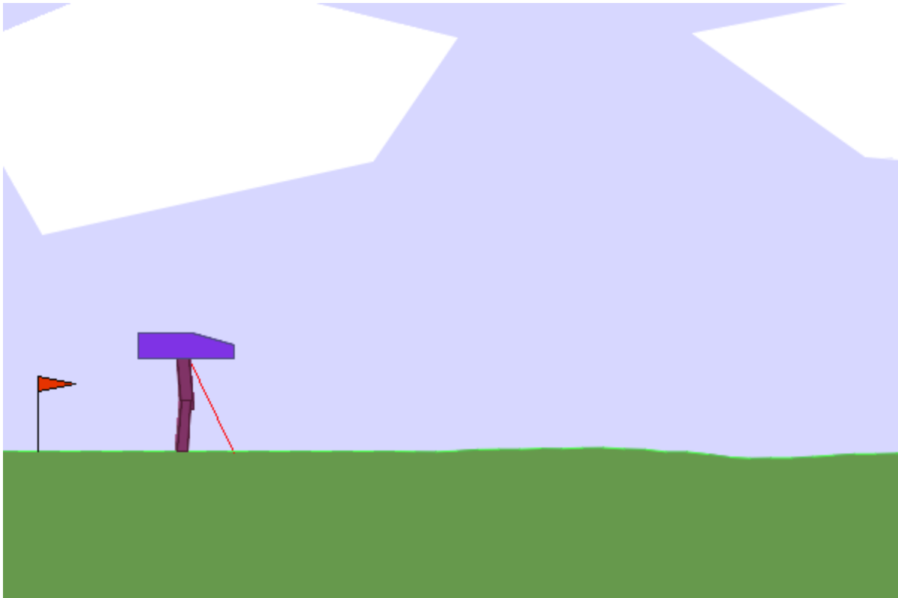
Demo

Slide 9
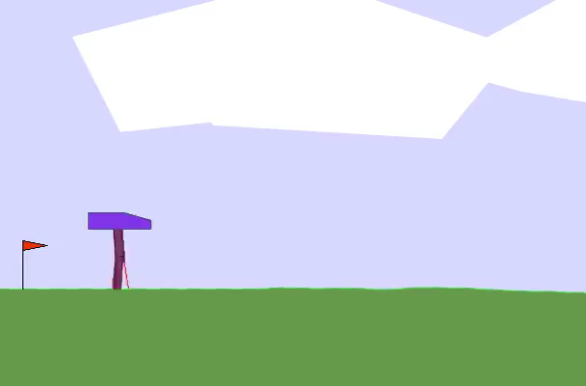
Demo

Slide 10
SUMMARY
The project aimed to train an RL agent within the challenging Bipedal Walker environment using TensorFlow Agents and OpenAI Gym.
Despite hurdles in environment complexities and training stability, the project successfully implemented an RL agent, visualizing its learning through embedded videos.
Identified future enhancements include advanced algorithms and innovative strategies for improved performance.
This project lays the groundwork for refining reinforcement learning in complex environments, marking a significant step in advancing RL methodologies for Bipedal Walker scenarios.

Slide 11
Bibliography
https://www.technologyreview.com/2020/03/02/905593/ai-robot-learns-to-walk-autonomously-reinforcement-learning/
https://www.youtube.com/watch?v=L_4BPjLBF4E
https://gymnasium.farama.org/

Slide 12
THANK YOU

